Slide 1

Detecting Logging of Forest Trees using Sound Event Detection
Major Project Phase - II
Review – 3
Team Members (Team - 17)
19K41A0594 - Boda Raju
19K41A0510 - Jinukala Vamshi
19K41A0517 - Mohammed Raamizuddin
19K41A05E9 - Bhonagiri Shreya
19K41A05F7 - Jupally Yochitha
Project Guide
Sallauddin Mohmmad
Assistant Professor, Dept of CSE

Slide 2
Contents
01.
Introduction
02.
Methodology
03.
Result Analysis
04.
Conclusion
MJP (DLFTSED) Team – 17 P-II Review – 3 (AY: 2022-2023)

Slide 3
Introduction
Tree logging is an illegal activity.
India is ranked third for illegally importing logged timber in the world.
The issue must be dealt very seriously as it exhausts the forest assets and may increase deforestation.
As a result, increasing the efficacy of surveillance for unlawful activities and logging is required.
Automated detection approaches are required for detecting these unlawful activities.
MJP (DLFTSED) Team – 17 P-II Review – 3 (AY: 2022-2023)

Slide 4
Objectives
Primary Objectives:
Prevention of illegal logging of forest trees.
Enhance Surveillance Techniques.
Sound Event Detection.
Implemented by using:
Sound Feature Extraction Techniques.
Deep learning techniques for Classification.
MJP (DLFTSED) Team – 17 P-II Review – 3 (AY: 2022-2023)

Slide 5
Existing Methods
Ground patrols are utilized to monitor forests and detect illegal tree-cutting .
Analyzing satellite imagery to identify changes in the landscape, such as the disappearance of trees.
Monitoring the forest assets visually requires a lot of equipment.
Monitoring by staff patrols with on-ground control is too expensive and time-consuming to offer capillary and widespread monitoring.
MJP (DLFTSED) Team – 17 P-II Review – 3 (AY: 2022-2023)

Slide 6
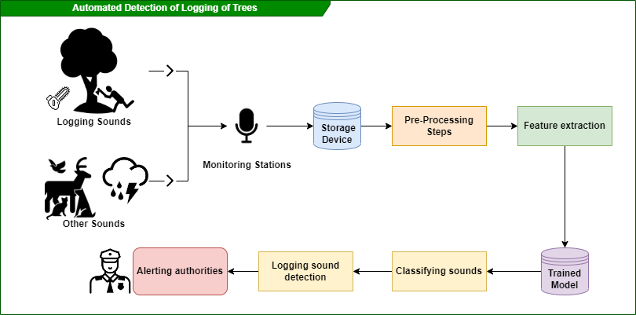
Proposed Methodology
The solution to the mentioned problem can be achieved by using the below workflow :
MJP (DLFTSED) Team – 17 P-II Review – 3 (AY: 2022-2023)

Slide 7
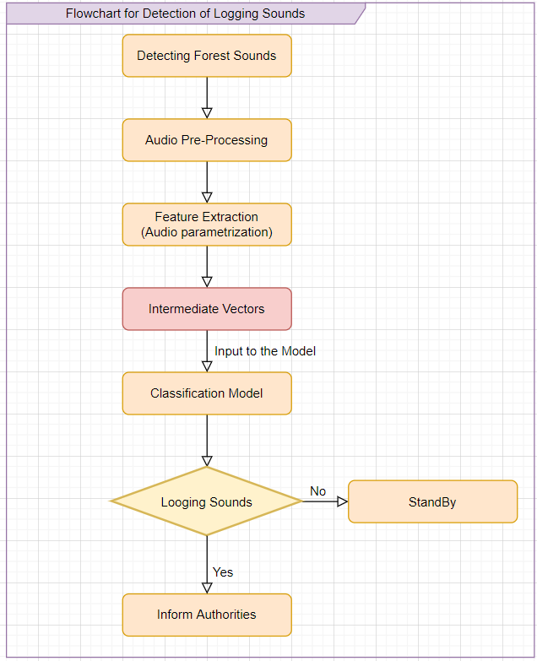
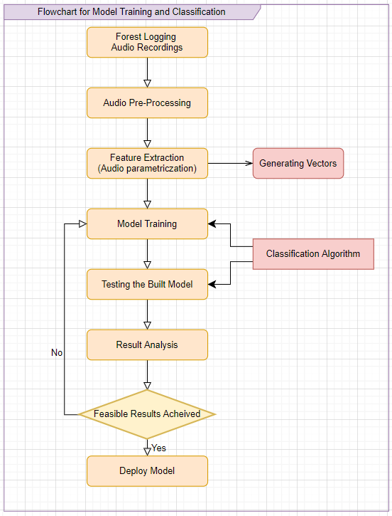
Flowchart for Model Training
MJP (DLFTSED) Team – 17 P-II Review – 3 (AY: 2022-2023)

Slide 8
Dataset
The dataset contains equal positive and negative classes, and the orthogonality of the data is high.
There are six annotated classes in the dataset (Chainsaw, Handsaw, Axe cutting, Wind, Forest, Rain and Thunder Sounds).
Each class has 1200 samples. Therefore, 7200 audio files.
The audio files are 10 seconds each.
MJP (DLFTSED) Team – 17 P-II Review – 3 (AY: 2022-2023)

Slide 9
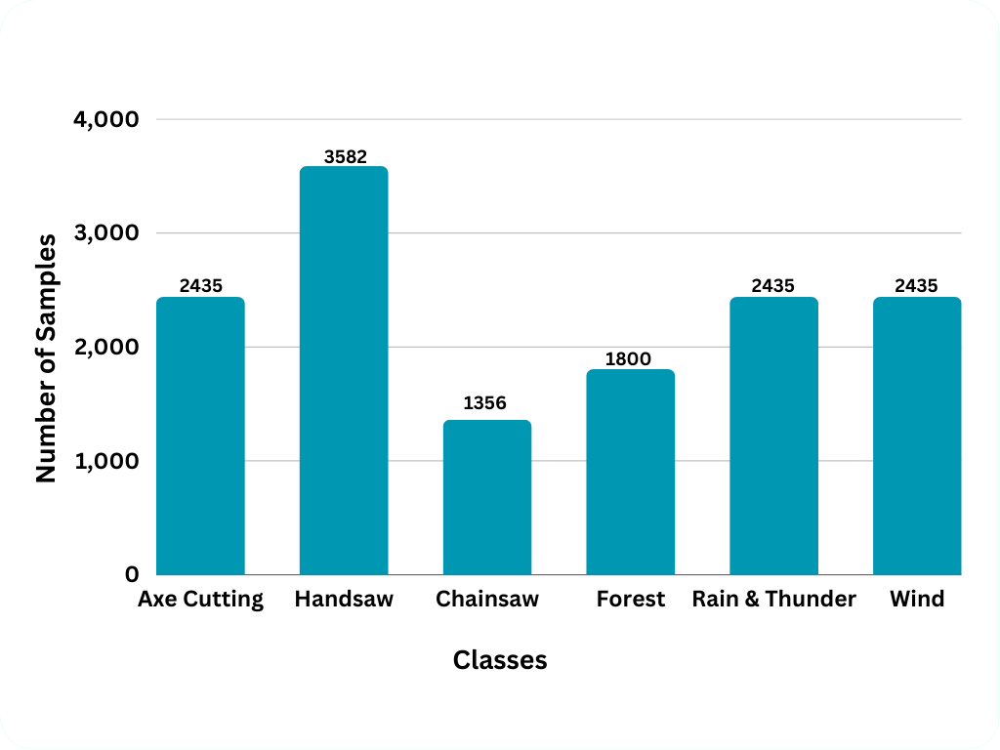
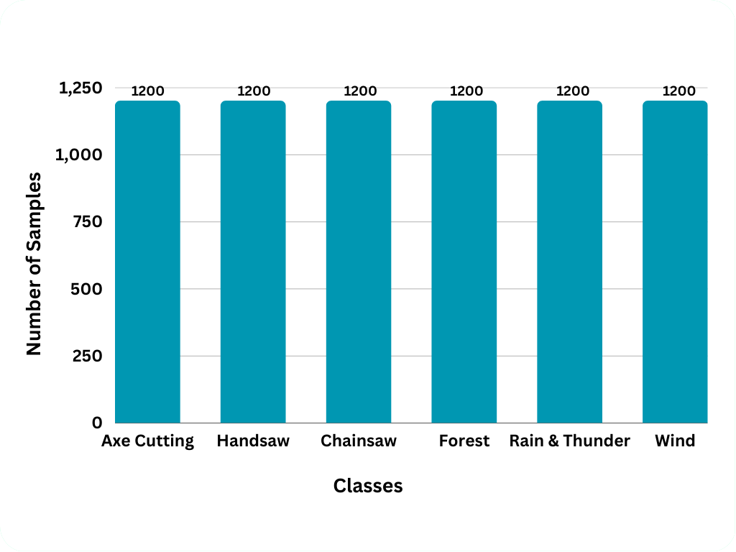
Dataset (Contd.)
The number of samples gathered and the number of samples utilized for training, testing and validation are shown below
MJP (DLFTSED) Team – 17 P-II Review – 3 (AY: 2022-2023)

Slide 10
Audio Pre-Processing
The audio samples collected were of various durations.
All the samples were divided into several samples of ten seconds each in order to keep the samples of same duration.
The class with least samples was chainsaw sounds with 1356 samples and the class with highest samples was handsaw sounds with 3582 samples.
1200 samples were selected at random in order to avoid imbalance of data.
Audio sampling was performed, and data was loaded into the python.
MJP (DLFTSED) Team – 17 P-II Review – 3 (AY: 2022-2023)

Slide 11
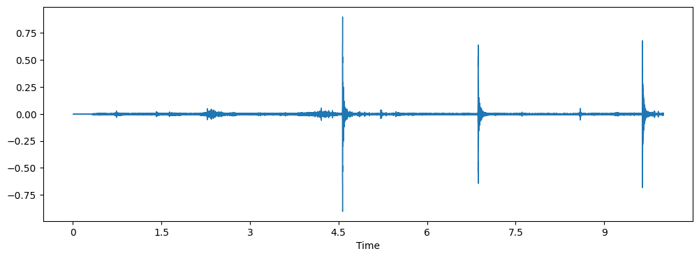
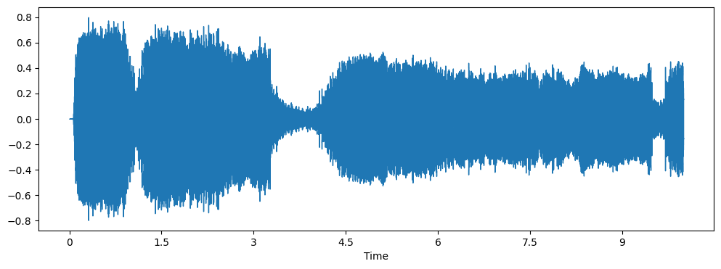
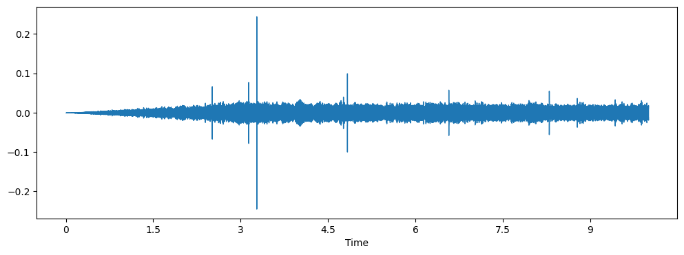
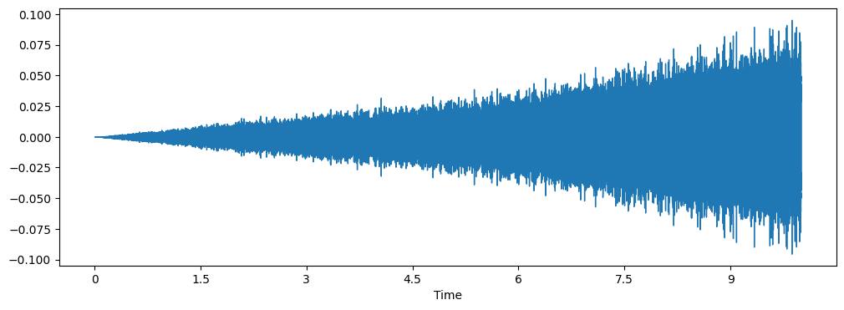
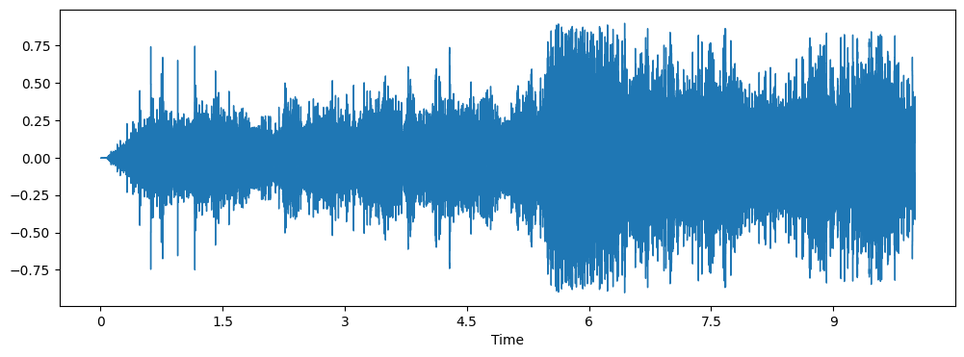
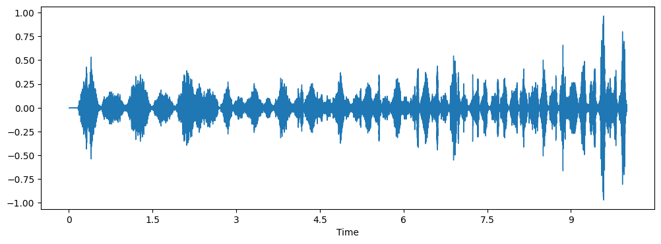
Audio Waveforms
Below are the audio waveform representations of some audio class
Axe cutting Sounds
Chainsaw Sounds
Forest Sounds
Wind Sounds
Rain and Thunder
Handsaw
MJP (DLFTSED) Team – 17 P-II Review – 3 (AY: 2022-2023)

Slide 12
Feature Extraction Techniques Used
MFCC: The Mel-frequency Cepstrum coefficient is a representation of the short-term power spectrum of a sound.
SPECTRAL CONTRAST: It is the decibel difference between peaks and valleys, that helps for echancing of sounds.
MEL-SPECTROGRAM: It is used for rendering the frequencies above a certain threshold frequency.
CHROMA: The value of an audio which represents the intensity of twelve distinctive pitch classes that are used to analyse music.
TONNETZ: It is used for computing the tonal centroid features of sound.
MJP (DLFTSED) Team – 17 P-II Review – 3 (AY: 2022-2023)

Slide 13
Feature Extraction (Contd.)
Data/Feature | Dimensions
Sampling Rate | 22050
Audio File | (220500,)
MFCC Matrix | (40, 431)
STFT | (1025, 431)
Chroma gram Matrix | (12, 431)
Mel Spectrogram Matrix | (128, 431)
Spectral Contrast Matrix | (7, 431)
Tonal Centroid Features Matrix | (6, 431)
Feature Dimensions
MJP (DLFTSED) Team – 17 P-II Review – 3 (AY: 2022-2023)

Slide 14
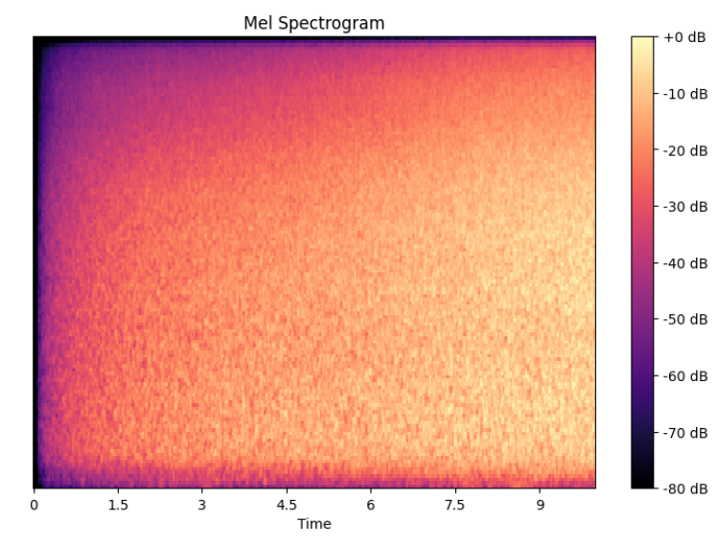
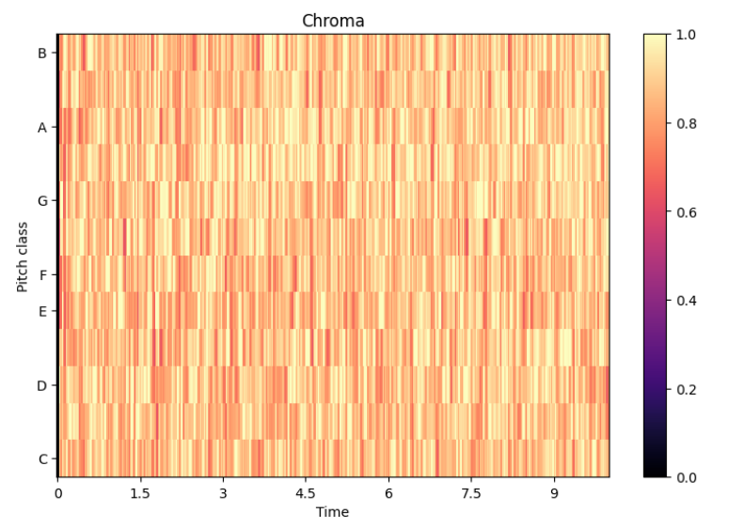
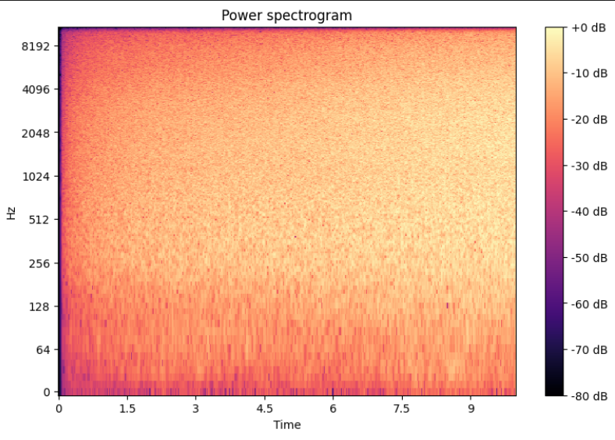
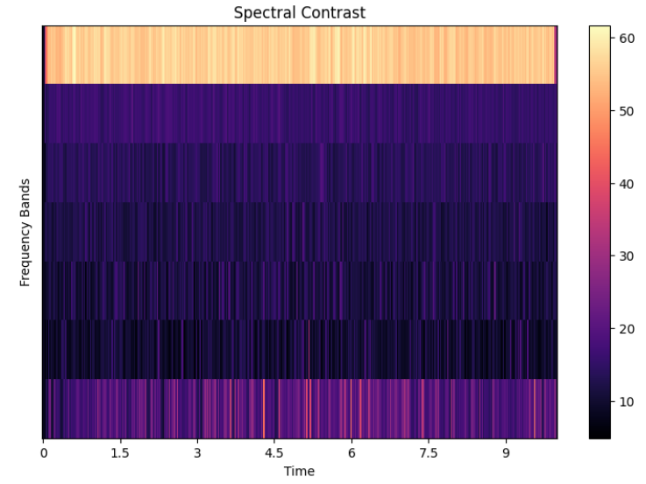
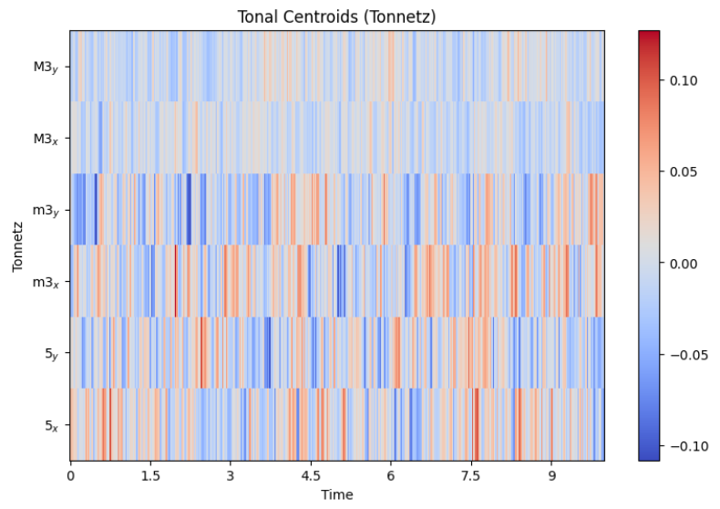
Feature Extraction Image Representation
Below are the representations of various feature extraction techniques:
MJP (DLFTSED) Team – 17 P-II Review – 3 (AY: 2022-2023)

Slide 15
Models Used
Various CNN models were trained using the extracted features.
The models considered for analysis at this stage are:
Convolutional Neural Network (CNN)
Convolutional Recurrent Neural Network (CRNN)
Bi-directional Convolutional Recurrent Neural Network (BI-CRNN)
These models are considered for analyzing the results and improving the efficiency of classification further by altering the architecture or tuning the hyperparameters.
MJP (DLFTSED) Team – 17 P-II Review – 3 (AY: 2022-2023)

Slide 16
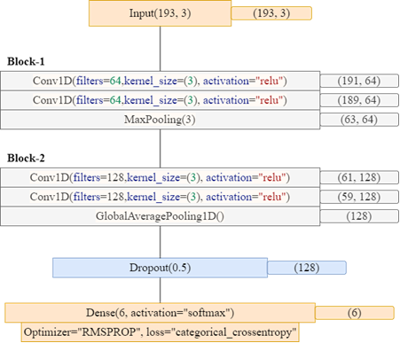
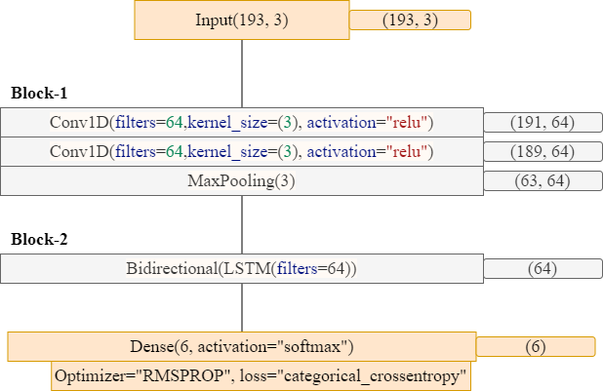
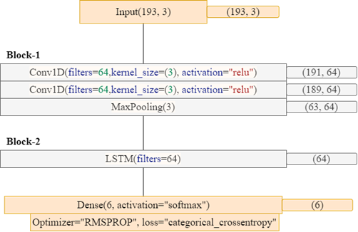
Model Architecture
The architectures of models are represented below:
CNN
BICRNN
CRNN
MJP (DLFTSED) Team – 17 P-II Review – 3 (AY: 2022-2023)

Slide 17
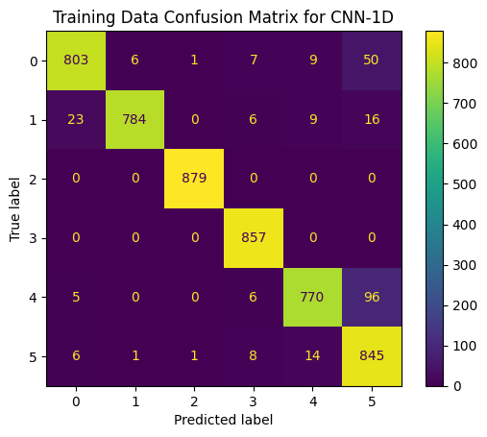
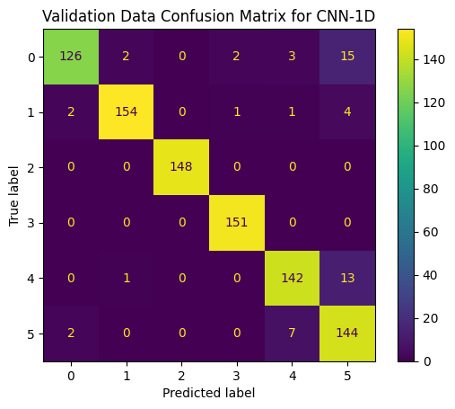
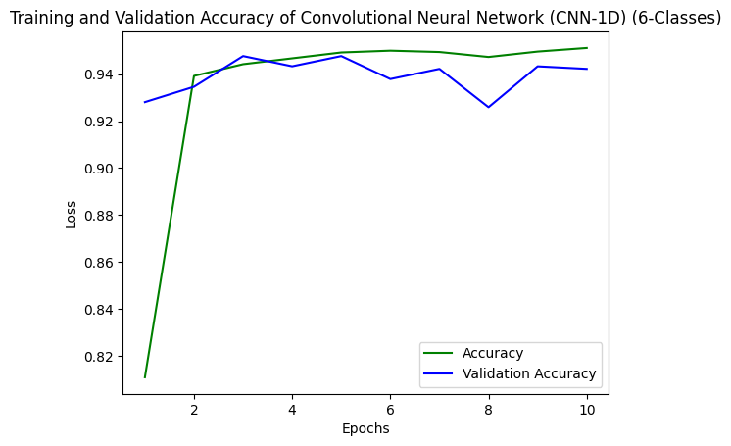
Result Analysis
The Confusion matrices of Convolutional Neural Network (CNN) is given below:
MJP (DLFTSED) Team – 17 P-II Review – 3 (AY: 2022-2023)

Slide 18
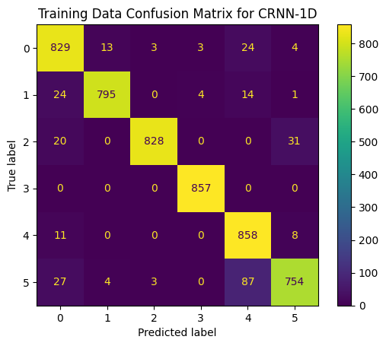
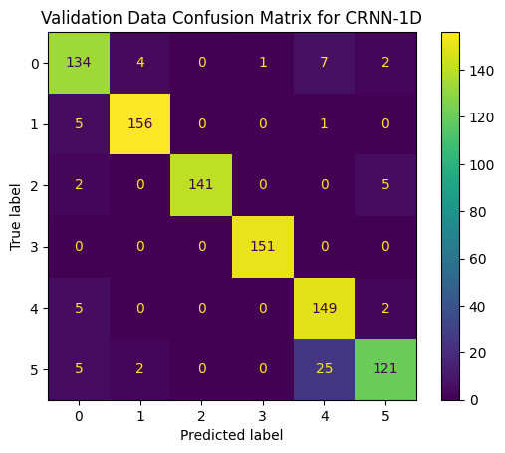
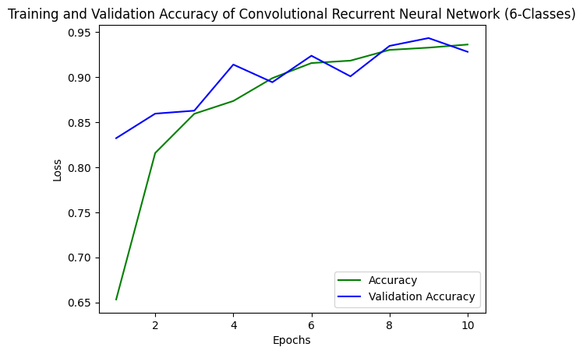
Result Analysis
The Confusion matrices of Convolutional Recurrent Neural Network (CRNN) is given below:
MJP (DLFTSED) Team – 17 P-II Review – 3 (AY: 2022-2023)

Slide 19
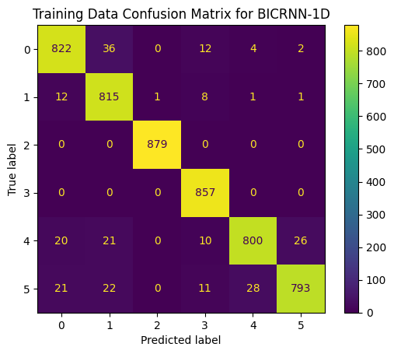
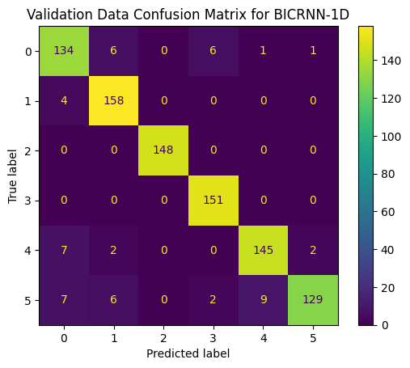
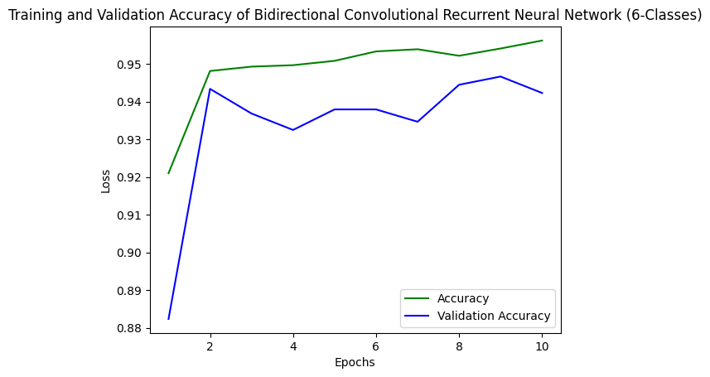
Result Analysis
The Confusion matrices of Bi-Convolutional Neural Network (BICNN) is given below:
MJP (DLFTSED) Team – 17 P-II Review – 3 (AY: 2022-2023)

Slide 20
Result Analysis (Contd.)
Accuracy and loss for the models are shown below
Type | CNN |  | CRNN |  | Bi-CRNN
 | Accuracy | Loss | Accuracy | Loss | Accuracy | Loss
Training | 0.951 | 0.204 | 0.938 | 0.150 | 0.956 | 0.132
Testing | 0.950 | 1.680 | 0.938 | 0.150 | 0.952 | 0.159
Validation | 0.942 | 0.204 | 0.928 | 0.182 | 0.942 | 0.200
MJP (DLFTSED) Team – 17 P-II Review – 3 (AY: 2022-2023)

Slide 21
Conclusion
A Concept for automatic detection of logging activity in forests using audio recordings was presented.
Audio pre-processing techniques were studied.
The various feature extraction techniques were discussed.
Extracted features are classified using various models and the results were compared.
The comparison of results shows that the best model for detecting logging of forest trees is BI-CRNN with 95% Accuracy.
MJP (DLFTSED) Team – 17 P-II Review – 3 (AY: 2022-2023)

Slide 22
Future Scope
The model was only investigated using six classes, hence our findings are limited to six audio classes, the classes can be extended to many more audio recordings.
Multi-labelled audio classification can be implemented such that the system can be made more accurate.
Localization concept is also being researched such that the system can also locate the source of sound.
In the future, the proposed approach can be applied to various other sound event detection domains.
MJP (DLFTSED) Team – 17 P-II Review – 3 (AY: 2022-2023)

Slide 23
Thank You
MJP (DLFTSED) Team – 17 P-II Review – 3 (AY: 2022-2023)

